Slide 1
1D MHD shocks
Justin Angus and Tony Link

Slide 2
Schematic of basic 1D hydrodynamic shock
Lab Frame
Shock Frame
u₁
u₂
u₁-u_{s}
u₂-u_{s}
u_{s}
𝜌₁, P₁
(up stream)
𝜌₂, P₂
(down stream)
𝜌₁, P₁
(up stream)
𝜌₂, P₂
(down stream)

Slide 3
1D Euler Equations
γ is the adiabatic coefficient (5/3 for ideal gas) and P is the pressure

Slide 4
Jump conditions
Lab Frame
Frame where upstream fluid is at rest

Slide 5
Reduced Expressions and expression for density ratio
Working in the frame where upstream fluid is at rest, the mass conservation law can be inserted into the momentum and energy conservation equations, respectively, to give
These two equations can be combined to give the expression for the density ratio
Density jump is 4 for ideal gas in strong shock limit (P₂>>P₁)

Slide 6
Shock speed and downstream speed
The shock speed can be determined by inserting the expression for the density ratio into
The downstream speed can be determined by inserting above expression for u_{s}-u₁ into

Slide 7
Summary of strong shock (P₂>>P₁) expressions
When the up stream fluid is at rest (u₁=0)
post-shock ram energy density is equal to the post-shock thermal energy density
shock moves faster than u₂ by (γ +1)/2

Slide 8
Entropy increase across shock

Slide 9
1D ideal MHD Equations (B normal to U)

Slide 10
Magnetic piston driven shocks in 1D MHD are the same as 1D Euler for small skin depth
The magnetic field diffuses in a skin current layer and JxB pushes the plasma up stream
There is no upstream B and B just inside the shock layer
Assuming that the skin depth is small compared to the shock layer, then the equations on either side of the shock front all the way back to the skin layer downstream are exactly 1D Euler and so all the shock conditions previously obtained hold
P* is constant on either side of the shock and the total downstream pressure (P*₂) transitions from all thermal to all magnetic as you cross the skin layer

Slide 11
Magnetic piston diagram (lab frame, u1=0)
Skin layer
Background gas
Post-shock plasma
Power input (dielectric surface)
u₂
Vacuum region
u_{s}
𝜌₁, P₁
(up stream)
𝜌₂, P₂
(down stream)

Slide 12
2-fluid model: quasi-neutral, inertia-less electrons, and negligible viscosity and heat flux (except in shock front)

Slide 13
2-Temp MHD model: Same as before, just rearranged some terms/equations

Slide 14
1D simplifications:

Slide 15
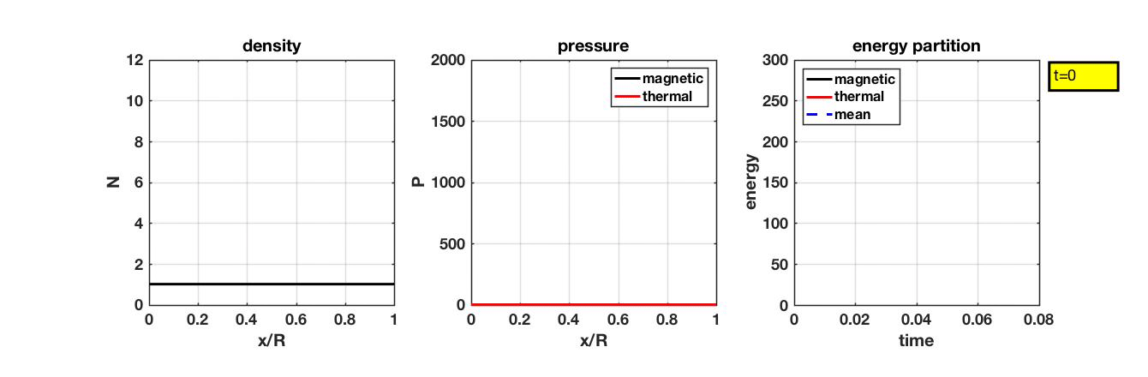
1D MHD Shock in Cartesian at 1MA/3Torr/3cm

Slide 16
Stagnation occurs at x=R/10 in Cartesian

Slide 17
Rate of Energy input into magnetic field is the same as rate of energy input into plasma for small skin layer
From Ampere’s law
E_{z}(R) and B_{y}(R) are fields at r=R
u_{x2} is piston velocity at skin layer
From Logic (B propagates in like a square pulse)
From total energy conservation

Slide 18
thermal energy at stagnation equals energy stored in magnetic field

Slide 19
Average temperate at stagnation is what formula predicts

Slide 20
Pressure increase by factor of 6 at stagnation
All energy in plasma is thermal
Energy in plasma equals that in magnetic field
Magnetic field energy known from radius at stagnation
Total ram energy turns into thermal (factor 2)
R goes from ¼ to 1/10 during stagnation (factor 2.5)
This only gives total of factor of 5 though… the rest of the energy comes from return shock heating, which must come from piston

Slide 21
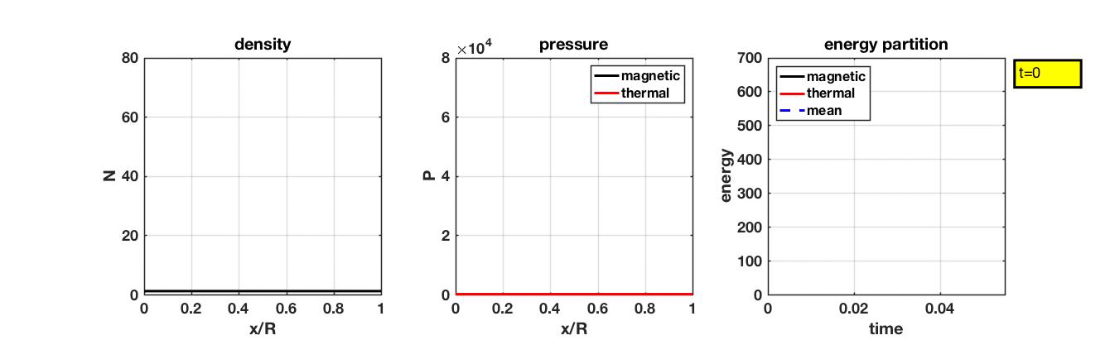
1D MHD Shock in Cylindrical at 1MA/3Torr/3cm

Slide 22
Stagnation occurs at r/R = 0.13 in cylindrical

Slide 23
Rate of Energy input into magnetic field is the same as rate of energy input into plasma for small skin layer even for cylindrical
From Ampere’s law:
From thin skin current
Also from thin skin current
From total energy conservation

Slide 24
Example B_{𝜃} from 1MA/3Torr/3cm run
Skin layer between r1(t) and r2(t)
Magnetic flux/energy in skin layer is much less than that in vacuum for thin skin layer
rB_{𝜃} propagates in like a square pulse

Slide 25
Thermal energy in pinch at stagnation equals energy stored in magnetic field
Average density at stagnation from mass conservation
Magnetic field energy at stagnation can be expressed in terms of current and compression ratio
Average pressure from energy balance equation

Slide 26
1D model gives average temperature at stagnation in terms of energy per unit length in magnetic field, particles per unit length, and adiabatic coefficient
μ₀I²/4𝜋 x ln(R/r_{s}) is energy per unit length in magnetic field at stagnation
𝜋R²n₀ is particles per unit length of plasma being compressed
I is current
γ is adiabatic coefficient (5/3 for ideal gas)
R/r_{s} is compression ratio (1.0/0.12=8.33 from 1D shock calculation)
Larger than Cartesian by 2 ln(0.12)/(1-0.1) = 4.71

Slide 27
Useful form of equation
Last two expressions give <Ti+Te> in units of eV where current I is in MA, anode radius R is in cm, fill density n₀ is in 1/cm³, D2 fill pressure P₀ is in Torr, and γ=5/3 is assumed

Slide 28
Pressure profiles at stagnation from 1MA/3Torr/3cm run in cylindrical matches that from formula
Average normalized density at stagnation from mass conservation is (R/r_{s})² = (1.0/0.13)² = 59
Average normalized total pressure at stagnation from formula is 4.6x10⁴

Slide 29
Ion temperature on axis at stagnation is about 4 times higher than <Ti+Te>/2
Average (Ti+Te)/2 at stagnation from formula is 777 eV
However, most of the pressure is in the ions and density is lower than average on axis, giving peak Ti about a factor of 4 higher than average from formula

Slide 30
On-axis ion temperature actually peaks a little later than stagnation
25 ns

Slide 31
Results are similar at 200kA/1.5Torr/1.5cm
Average (Ti+Te)/2 at stagnation from formula is 240 eV
However, most of the pressure is in the ions and density is lower than average on axis, giving peak Ti about a factor of 4 higher than average from formula

Slide 32
Global energy from MJ and kJ sims show magnetic field energy equals thermal energy at stagnation
1MA/3Torr/3cm
200kA/1.5Torr/1.5cm

Slide 33
r-weighted energy densities at stagnation have same area

Slide 34
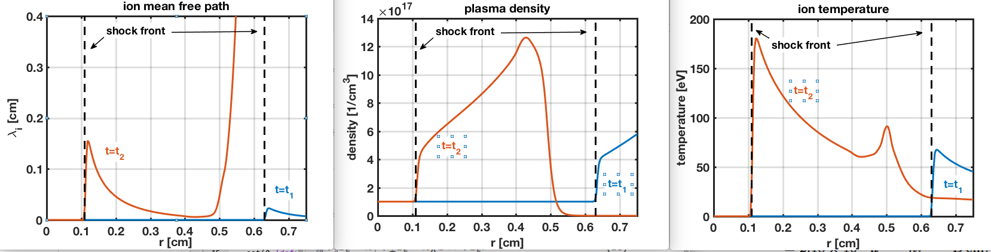
Ion-ion mean free path becomes comparable to shock-front position at about 1mm from axis in kJ-like sim

Slide 35
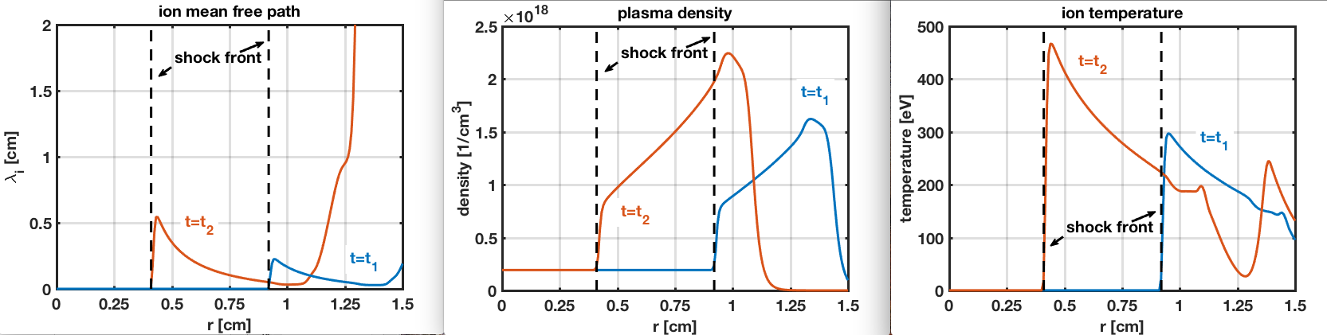
Ion-ion mean free path becomes comparable to shock-front position at about 5mm from axis in MJ-like sim

Slide 36
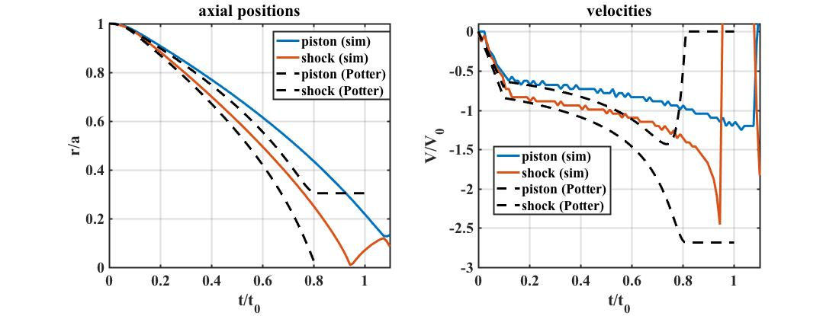
Comparing Theory by Potter (1978) with simulation for piston and shock front speed and position
Potter neglects inertia, transient effects, and geometry effects on pressure profile. All leading to a faster implosion and the piston coming to a stop once the shock reaches axis (no rebound shock)

Slide 37
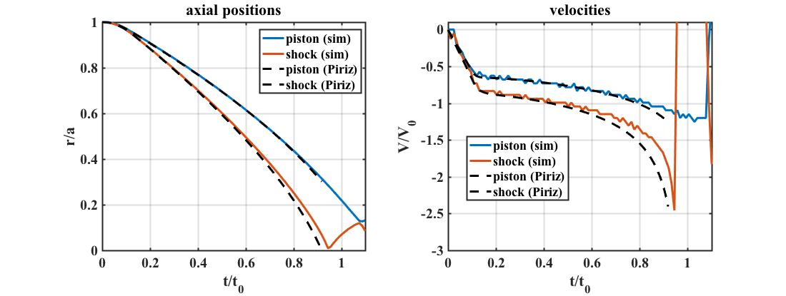
Comparing Theory by Piriz (2015) with simulation for piston and shock front speed and position
Piriz improved Potters model to include inertia and geometry effects on pressure profile using approximate models. However, this model still does not address reflected shock stage.
Also, they used Gausses law wrong, I fixed this and results shown are with fix

Slide 38
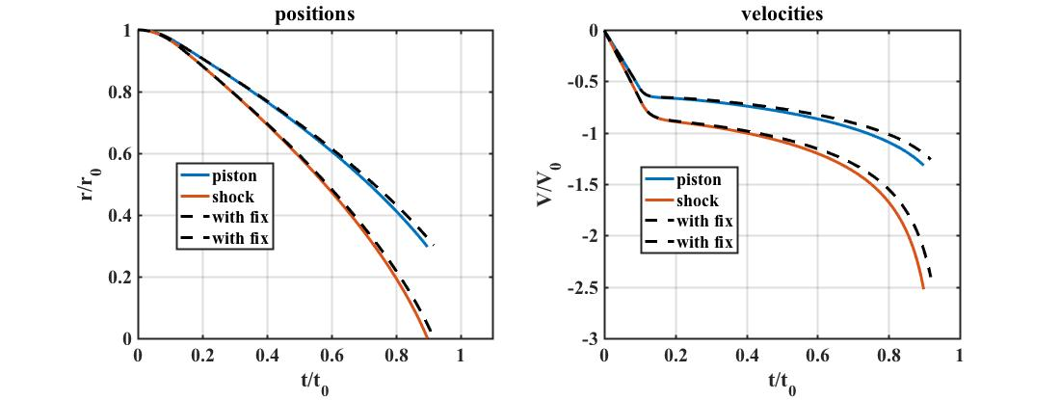
Piriz vs Piriz with fix to piston acceleration
Piriz didn’t use Gausses law correctly for cylindrical coordinates. This lead to a piston acceleration that is slightly larger than it should be. The difference is largest near axis. The difference is not large, but the dashed curves do agree better with the simulations.

Slide 39
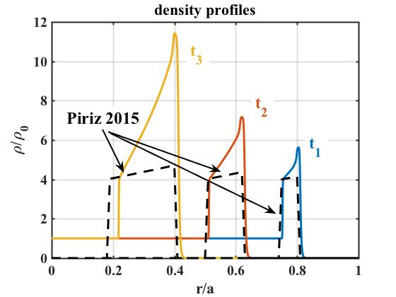
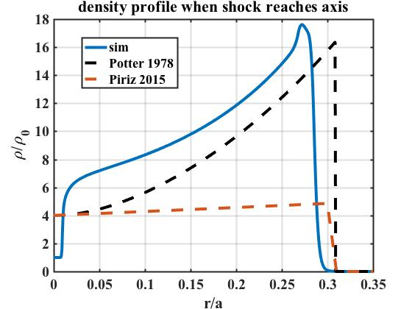
Density profile when shock reaches axis from Potter matches well with simulation, while Piriz profiles don’t even conserve mass properly.

Slide 40
Overview of Potter and Piriz models for shock and piston positions
Shock jump conditions
Post-shock fluid equations
Both models use post-shock fluid equations (not valid at shock front) with shock jump conditions used for boundary conditions at shock front position.
Note that Piriz used adiabatic law wrong by setting P/rho^gamma = constant…

Slide 41
Piriz’s model for fluid velocity in shocked plasma
Only assumption is that the total time derivative of the pressure is approximately equal to the total time derivative of the post-shock pressure, which is same as that made by Potter.
Only difference by Piriz is that he obtained velocity profile.
Equation relating shock and piston obtained by taking r=rp and u=up in last relation

Slide 42
1D dynamic pinch in planar geometry using Chicago’s Eulerian fluid model

Slide 43
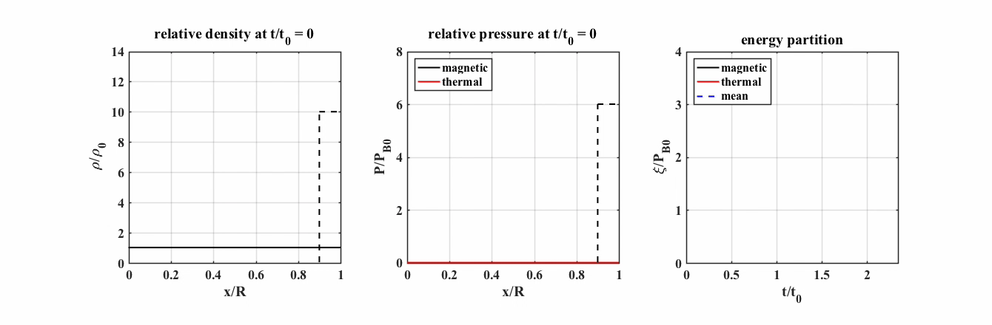
1D dynamic pinch sims with Chicago Eulerian fluid model in planar geometry
P = 3 Torr, R = 3 cm, I = 1 MA,
t0 = 128ns, u0 = 234cm/ns, cfl dt = dx/u0 = 0.011ns
dx = 2.5um, dt = 2.0e-3ns,
eulerian_filtering_parameter = 0.1, viscosity_coefficient = 0.0

Slide 44
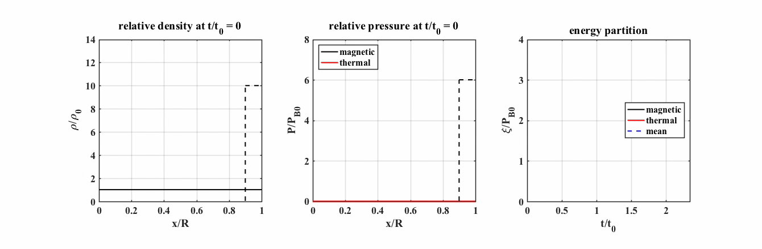
Simulation using standard fluid parameters gives way too much energy in the plasma and bad oscillations
P = 3 Torr, R = 3 cm, I = 1 MA,
t0 = 128ns, u0 = 234cm/ns, cfl dt = dx/u0 = 0.42ns
dx = 100um, dt = 1.0e-2ns,
eulerian_filtering_parameter = 0.0005, viscosity_coefficient = 0.002

Slide 45

Bad oscillations go away with increasing eulerian_filtering_parameter, but energy conservation still bad
P = 3 Torr, R = 3 cm, I = 1 MA,
t0 = 128ns, u0 = 234cm/ns, cfl dt = dx/u0 = 0.42ns
dx = 100um, dt = 1.0e-2ns,
eulerian_filtering_parameter = 0.1, viscosity_coefficient = 0.0

Slide 46

Energy conservation gets better with increasing grid resolution for 300 cells to 900 cells
P = 3 Torr, R = 3 cm, I = 1 MA,
t0 = 128ns, u0 = 234cm/ns, cfl dt = dx/u0 = 0.142ns
dx = 33.3um, dt = 1.0e-2ns,
eulerian_filtering_parameter = 0.1, viscosity_coefficient = 0.0

Slide 47

Too much smoothing with efp=0.1 and time step decreased from 1.0e-2ns to 1.0e-3ns
P = 3 Torr, R = 3 cm, I = 1 MA,
t0 = 128ns, u0 = 234cm/ns, cfl dt = dx/u0 = 0.142ns
dx = 33.3um, dt = 1.0e-3ns,
eulerian_filtering_parameter = 0.1, viscosity_coefficient = 0.0

Slide 48

Smoothing back to normal with efp also lowered by order of magnitude, but decreasing time step doesn’t improve energy conservation
P = 3 Torr, R = 3 cm, I = 1 MA,
t0 = 128ns, u0 = 234cm/ns, cfl dt = dx/u0 = 0.142ns
dx = 33.3um, dt = 1.0e-3ns,
eulerian_filtering_parameter = 0.01, viscosity_coefficient = 0.0

Slide 49

Also played with viscosity_coefficient. Saw no improvement, just another way to smooth
P = 3 Torr, R = 3 cm, I = 1 MA,
t0 = 128ns, u0 = 234cm/ns, cfl dt = dx/u0 = 0.142ns
dx = 33.3um, dt = 1.0e-2ns,
eulerian_filtering_parameter = 0.0, viscosity_coefficient = 1.0

Slide 50

Energy conservation gets better by increasing grid resolution again from nx=900 to nx=1800
P = 3 Torr, R = 3 cm, I = 1 MA,
t0 = 128ns, u0 = 234cm/ns, cfl dt = dx/u0 = 0.071ns
dx = 17um, dt = 1.0e-2ns,
eulerian_filtering_parameter = 0.1, viscosity_coefficient = 0.0

Slide 51
Energy conservation gets better by increasing grid resolution again from nx=1800 to nx=3000
P = 3 Torr, R = 3 cm, I = 1 MA,
t0 = 128ns, u0 = 234cm/ns, cfl dt = dx/u0 = 0.042ns
dx = 10um, dt = 1.0e-2ns,
eulerian_filtering_parameter = 0.1, viscosity_coefficient = 0.0

Slide 52

Energy conservation gets better by increasing grid resolution again from nx=3000 to nx=6000
P = 3 Torr, R = 3 cm, I = 1 MA,
t0 = 128ns, u0 = 234cm/ns, cfl dt = dx/u0 = 0.021ns
dx = 5um, dt = 1.0e-2ns,
eulerian_filtering_parameter = 0.1, viscosity_coefficient = 0.0

Slide 53
Energy conservation gets better by increasing grid resolution again from nx=6000 to nx=12000
P = 3 Torr, R = 3 cm, I = 1 MA,
t0 = 128ns, u0 = 234cm/ns, cfl dt = dx/u0 = 0.011ns
dx = 2.5um, dt = 2.0e-3ns,
eulerian_filtering_parameter = 0.1, viscosity_coefficient = 0.0

Slide 54
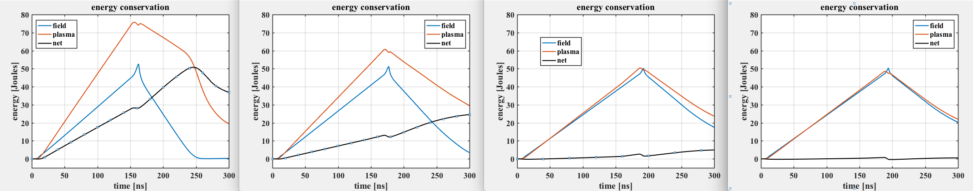
Net energy goes down with increasing grid resolution
nx=900
nx=1800
nx=6000
nx=12000

Slide 55
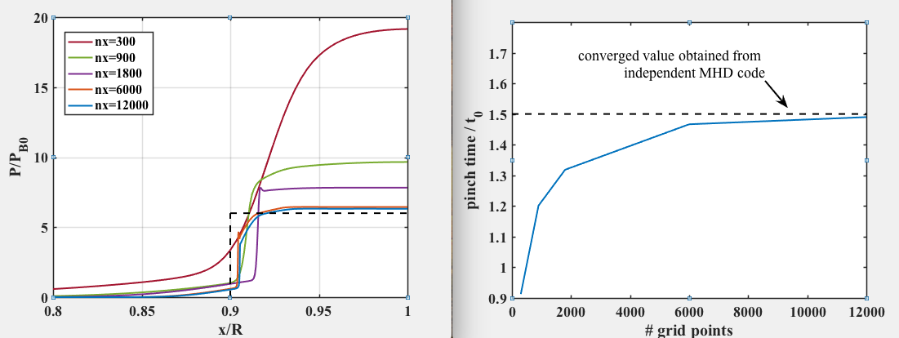
Stagnation pressure and pinch time approaches expected values for high resolution
Reflected pressure ratio is 6
Pinch time in units of t0 is 1.5
Stagnation occurs about 40% too soon with respect to run in time for 300 grid points
Stagnation pressure is too high by almost factor of 3 for 300 grid points

Slide 56
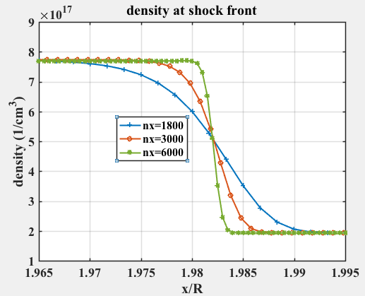
Why do I need such high resolution?
Shock front is under resolved and just gets narrower with increasing resolution
Actually have less grid cells across shock front with increasing resolution
Is shock width here sensitive to efp ?
*curves are slightly shifted in x to align

Slide 57
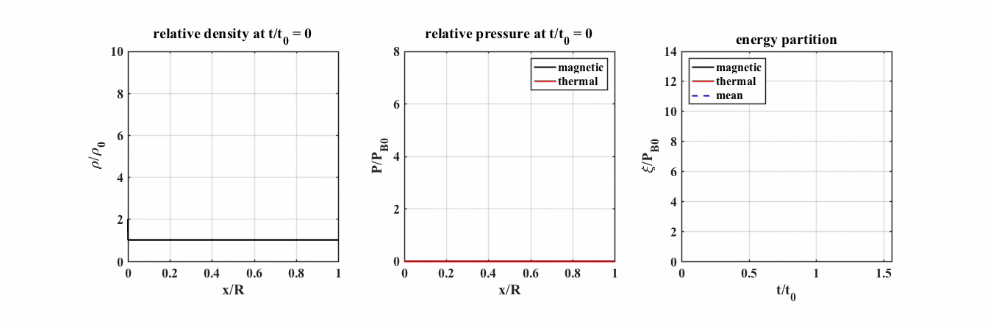
First test in cylindrical cords with nr=3000
P = 3 Torr, R = 3 cm, I = 1 MA,
t0 = 128ns, u0 = 234cm/ns, cfl dt = dx/u0 = 0.042ns
dx = 10um, dt = 1.0e-3ns,
eulerian_filtering_parameter = 0.1, viscosity_coefficient = 0.0

Slide 58
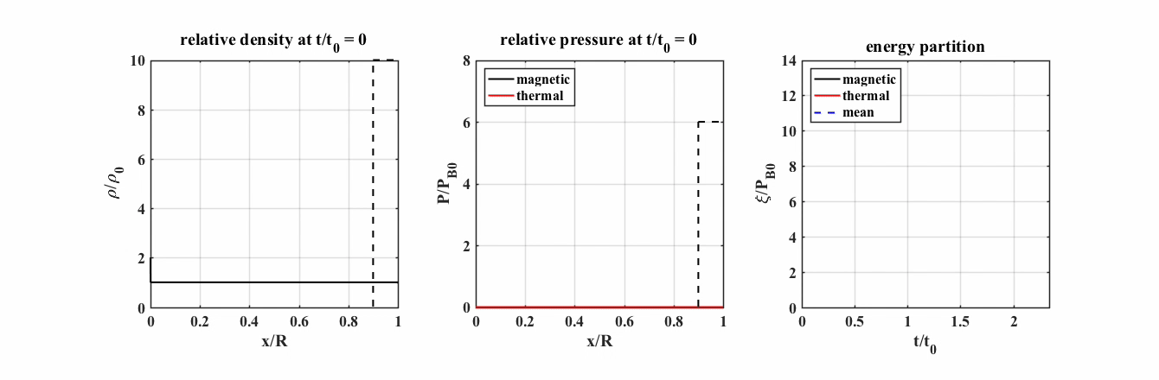
Adding viscosity gets rid of jagged stuff
P = 3 Torr, R = 3 cm, I = 1 MA,
t0 = 128ns, u0 = 234cm/ns, cfl dt = dx/u0 = 0.042ns
dx = 10um, dt = 1.0e-3ns,
eulerian_filtering_parameter = 0.1, viscosity_coefficient = 0.1

Slide 59

Increasing viscosity further causes too much smoothing and doesn’t improve energy conservation
P = 3 Torr, R = 3 cm, I = 1 MA,
t0 = 128ns, u0 = 234cm/ns, cfl dt = dx/u0 = 0.042ns
dx = 10um, dt = 1.0e-3ns,
eulerian_filtering_parameter = 0.1, viscosity_coefficient = 1.0

Slide 60
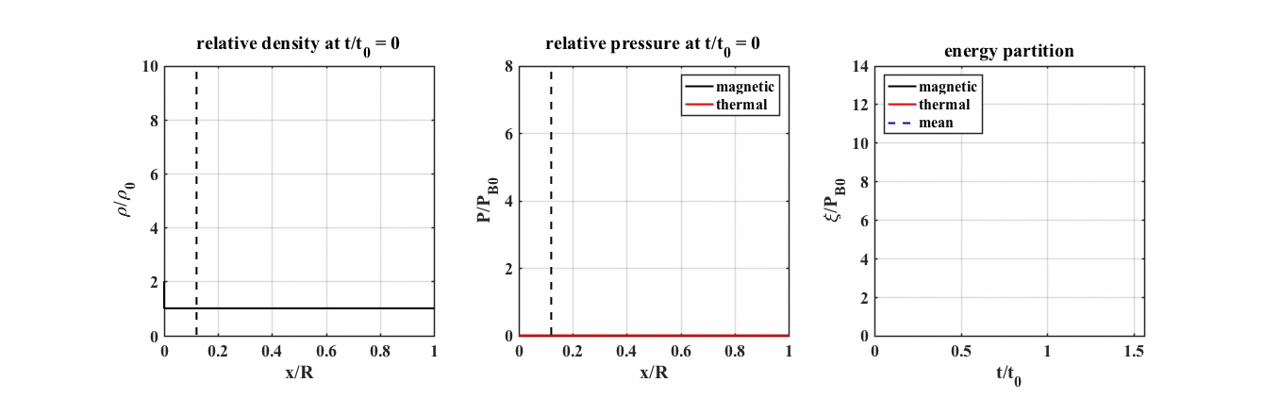
Things get better with increasing grid cells from 3000 to 6000
P = 3 Torr, R = 3 cm, I = 1 MA,
t0 = 128ns, u0 = 234cm/ns, cfl dt = dx/u0 = 0.021ns
dx = 5um, dt = 1.0e-3ns,
eulerian_filtering_parameter = 0.1, viscosity_coefficient = 0.1

Slide 61

6000 ➔ 12000 (getting warmer)
P = 3 Torr, R = 3 cm, I = 1 MA,
t0 = 128ns, u0 = 234cm/ns, cfl dt = dx/u0 = 0.01ns
dx = 2.5um, dt = 1.0e-3ns,
eulerian_filtering_parameter = 0.1, viscosity_coefficient = 0.1

Slide 62
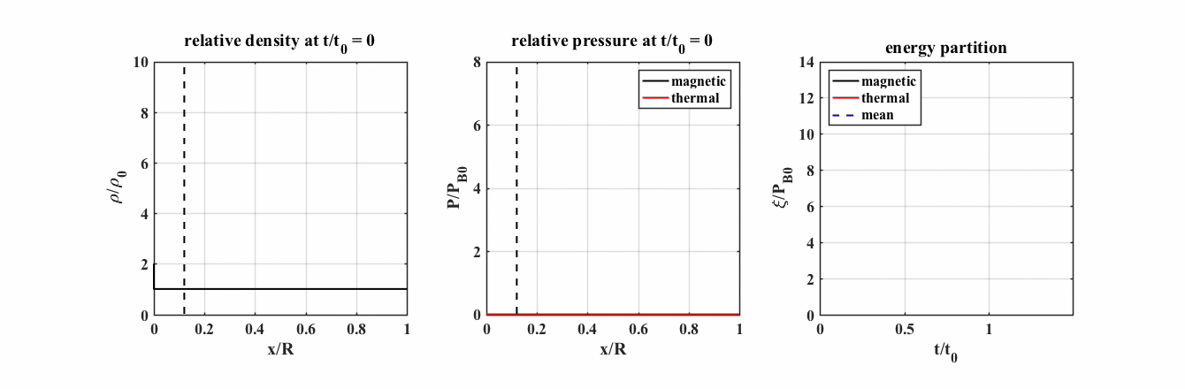
12000 ➔ 24000 (getting hot)
P = 3 Torr, R = 3 cm, I = 1 MA,
t0 = 128ns, u0 = 234cm/ns, cfl dt = dx/u0 = 0.005ns
dx = 1.25um, dt = 5.0e-4ns,
eulerian_filtering_parameter = 0.1, viscosity_coefficient = 0.1

Slide 63
1D shock test in cyl cords using kJ params
MJ params
kJ params
I = 1 MA
R = 3 cm
P = 3 Torr
Fundamental scales
t0 = 181 ns
u0 = 16.5 cm/us
I = 200 kA
R = 1.5 cm
P = 1.5 Torr
Fundamental scales
t0 = 160 ns
u0 = 9.36 cm/us

Slide 64
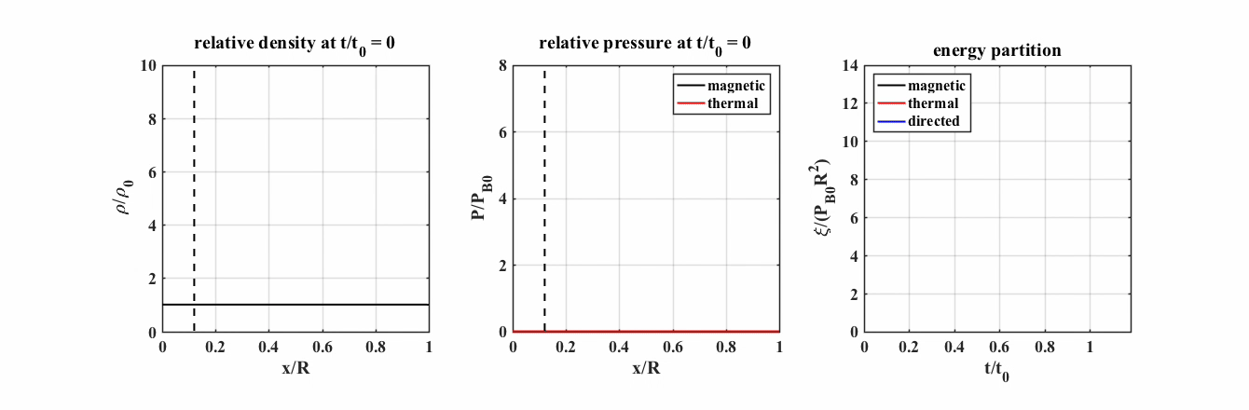
150 grid cells (100 um) is horrible for kJ
P = 1.5 Torr, R = 1.5 cm, I = 200 kA,
t0 = 160 ns, u0 = 9.36 cm/us
nx=150, dx = 100 um, dt = 1.0e-2 ns, cfl dt = dx/u0 = 1.06 ns
eulerian_filtering_parameter = 0.005, viscosity_coefficient = 0.001

Slide 65

1500 grid cells is decent for kJ
P = 1.5 Torr, R = 1.5 cm, I = 200 kA,
t0 = 160 ns, u0 = 9.36 cm/us
nx=1500, dx = 10 um, dt = 1.0e-2 ns, cfl dt = dx/u0 = 0.106 ns
eulerian_filtering_parameter = 0.1, viscosity_coefficient = 0.1

Slide 66

3000 grid cells is better for kJ
P = 1.5 Torr, R = 1.5 cm, I = 200 kA,
t0 = 160 ns, u0 = 9.36 cm/us
nx=3000, dx = 5 um, dt = 5.0e-3 ns, cfl dt = dx/u0 = 0.053 ns
eulerian_filtering_parameter = 0.1, viscosity_coefficient = 0.1

Slide 67

6000 grid cells is good for kJ
P = 1.5 Torr, R = 1.5 cm, I = 200 kA,
t0 = 160 ns, u0 = 9.36 cm/us
nx=6000, dx = 2.5 um, dt = 2.0e-3 ns, cfl dt = dx/u0 = 0.027 ns
eulerian_filtering_parameter = 0.1, viscosity_coefficient = 0.1

Slide 68
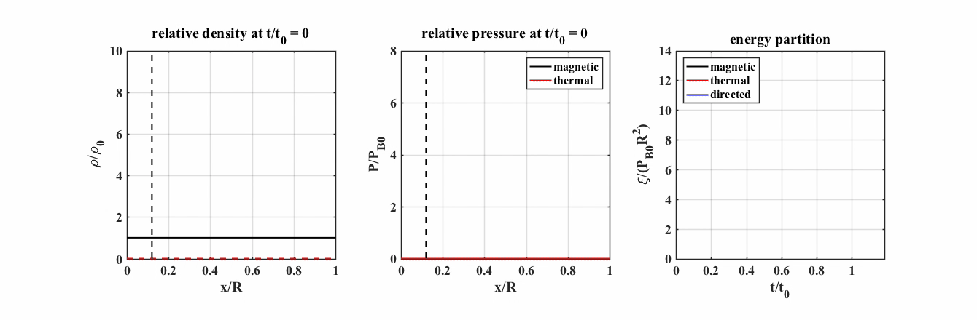
6000 grid cells using nonlLTE for kJ
P = 1.5 Torr, R = 1.5 cm, I = 200 kA,
t0 = 160 ns, u0 = 9.36 cm/us
nx=6000, dx = 2.5 um, dt = 2.0e-3 ns, cfl dt = dx/u0 = 0.027 ns
eulerian_filtering_parameter = 0.1, viscosity_coefficient = 0.1

Slide 69

12000 grid cells is really good for kJ
P = 1.5 Torr, R = 1.5 cm, I = 200 kA,
t0 = 160 ns, u0 = 9.36 cm/us
nx=12000, dx = 1.25 um, dt = 5.0e-4 ns, cfl dt = dx/u0 = 0.013 ns
eulerian_filtering_parameter = 0.1, viscosity_coefficient = 0.1

Slide 70
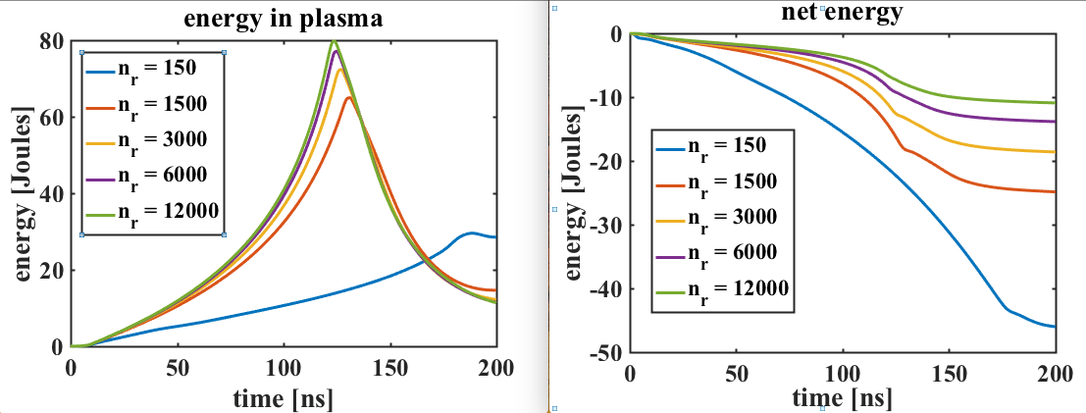
1D kJ-like pinch sim converges at stagnation with about 1um resolution

Slide 71
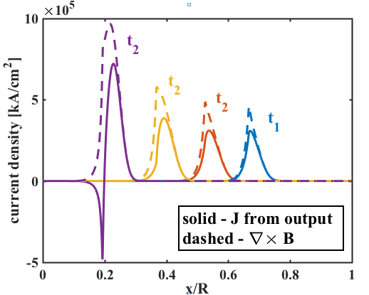
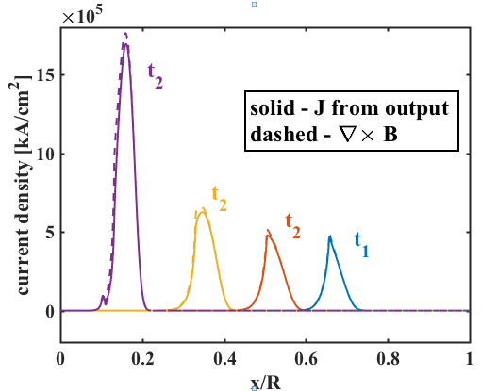
Inconsistency between J from output and ∇×B
Medium resolution (nr=1500)
High resolution (nr=12000)

Slide 72
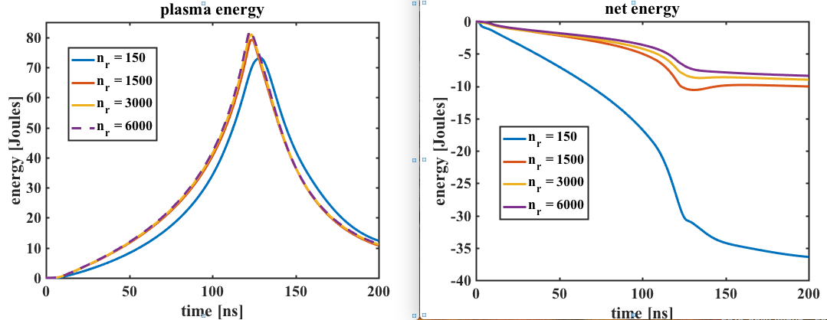
1D kJ-like pinch sim converges at stagnation with about 10um resolution using latest Chicago
* Net energy probe seems too large?

Slide 73
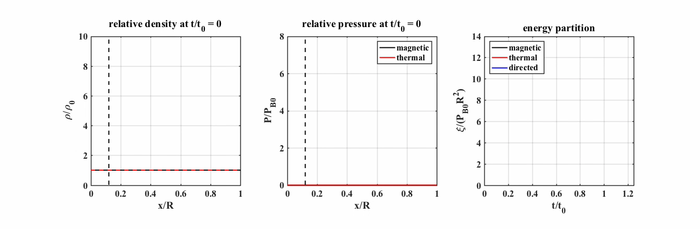
New Chicago works much better. Why?
P = 1.5 Torr, R = 1.5 cm, I = 200 kA,
t0 = 160 ns, u0 = 9.36 cm/us
nx=3000, dx = 5 um, dt = 5.0e-3 ns, cfl dt = dx/u0 = 0.053 ns
eulerian_filtering_parameter = 0.1, viscosity_coefficient = 0.1

Slide 74

New Chicago works much better. Why?
P = 1.5 Torr, R = 1.5 cm, I = 200 kA,
t0 = 160 ns, u0 = 9.36 cm/us
nx=300, dx = 50 um, dt = 1.0e-2 ns, cfl dt = dx/u0 = 0.53 ns
eulerian_filtering_parameter = 0.05, viscosity_coefficient = 0.005

Slide 75
New Chicago works much better. Why?
P = 1.5 Torr, R = 1.5 cm, I = 200 kA,
t0 = 160 ns, u0 = 9.36 cm/us
nx=900, dx = 16.67 um, dt = 1.0e-2 ns, cfl dt = dx/u0 = 0.18 ns
eulerian_filtering_parameter = 0.05, viscosity_coefficient = 0.005

